Slide 1

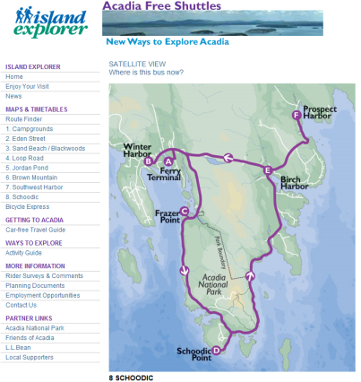
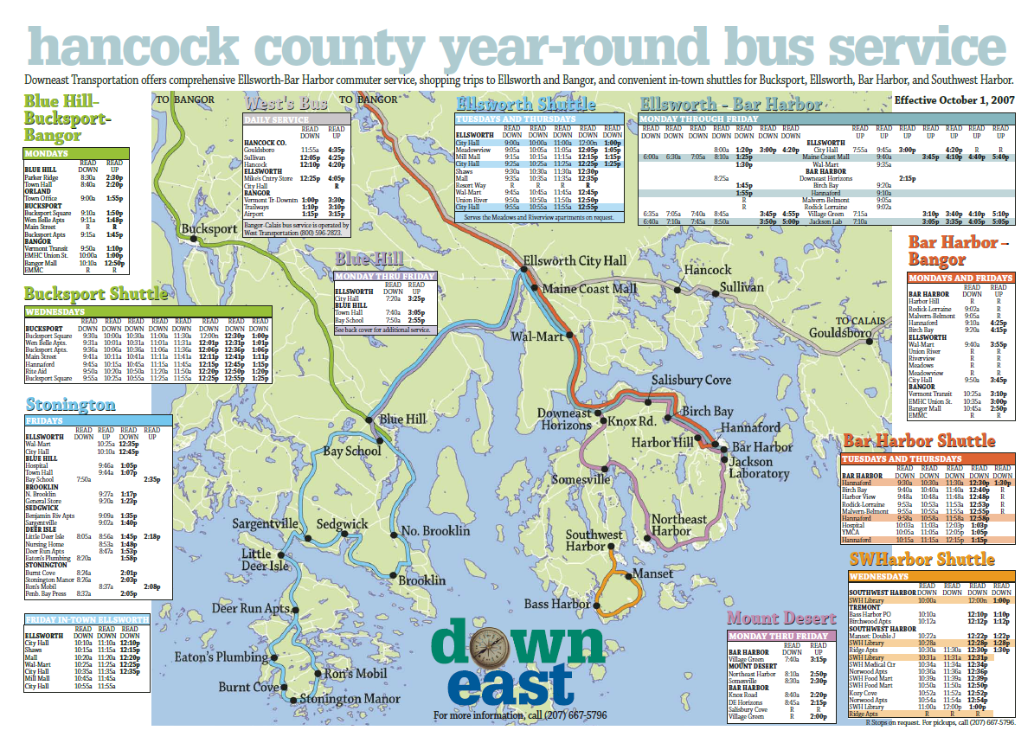

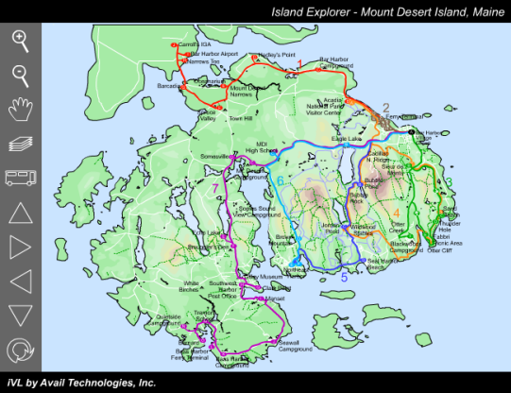
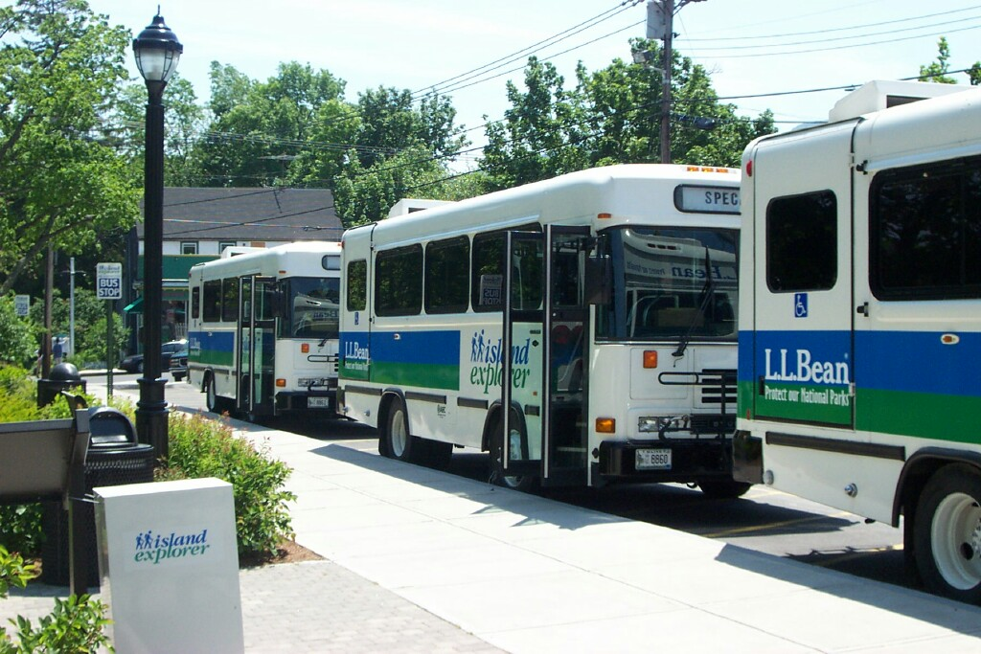
Transit and Scenic Byways
Acadia and Schoodic
Presentation by Jim Fisher, PhD, AICP
Hancock County Planning Commission
Maine
January 12, 2011

Slide 2
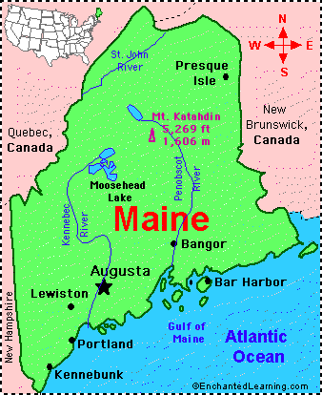
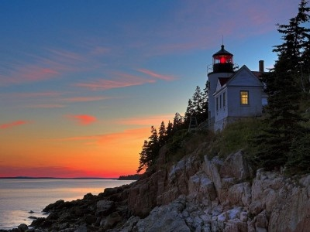



Downeast Maine

Slide 3
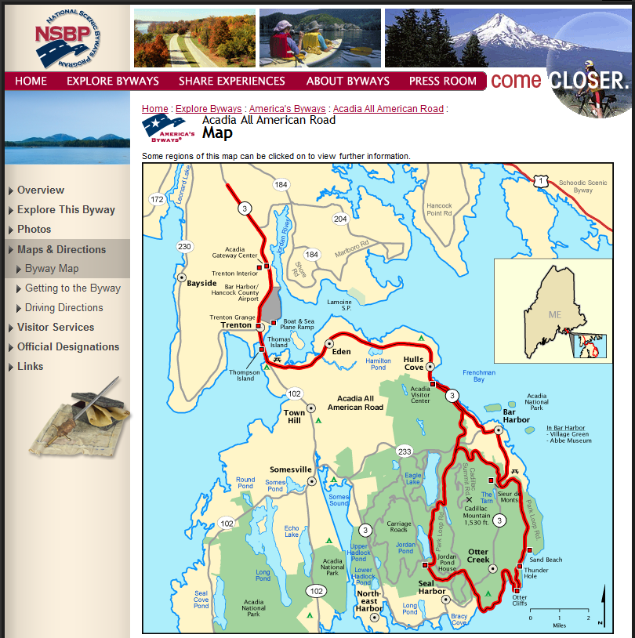
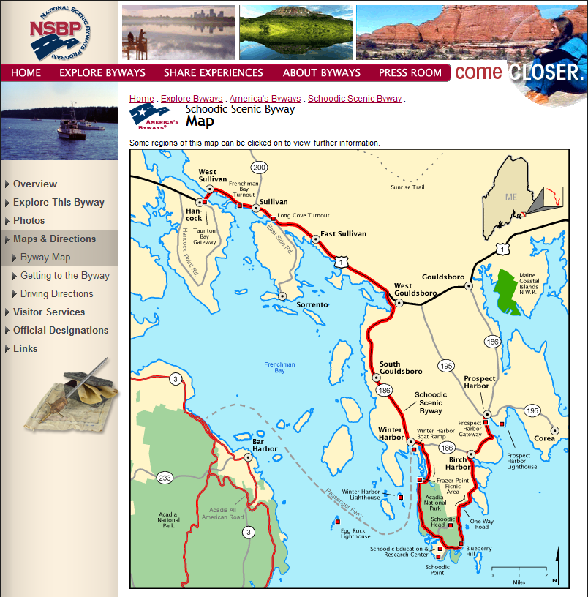
A Trail of Two Byways

Slide 4
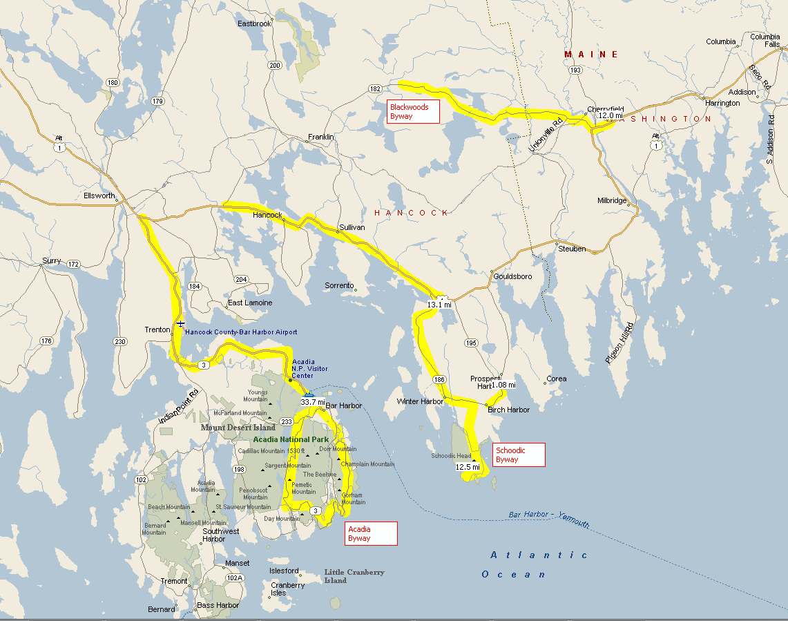
Hancock County Scenic Byways

Slide 5
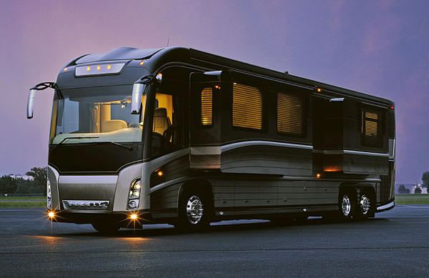
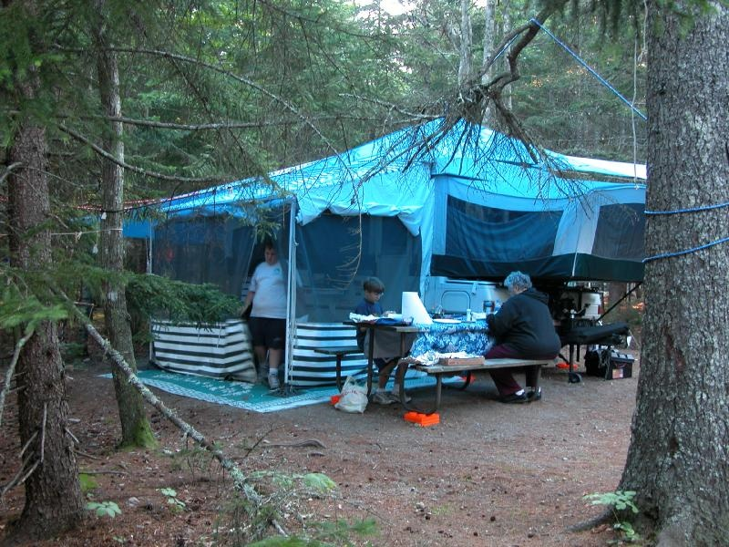
Customers: RV Operators

Slide 6
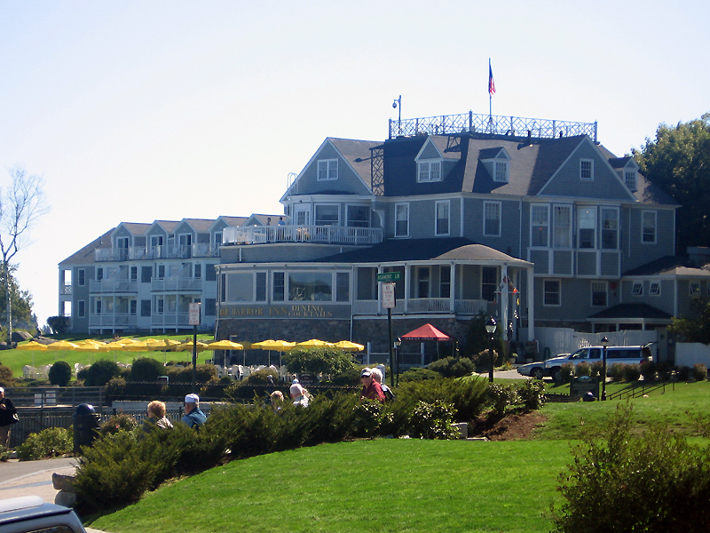
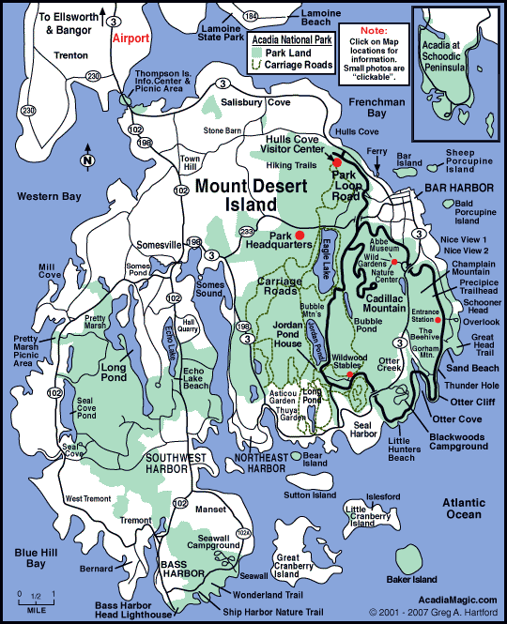
Customers: Overnight Tourists

Slide 7
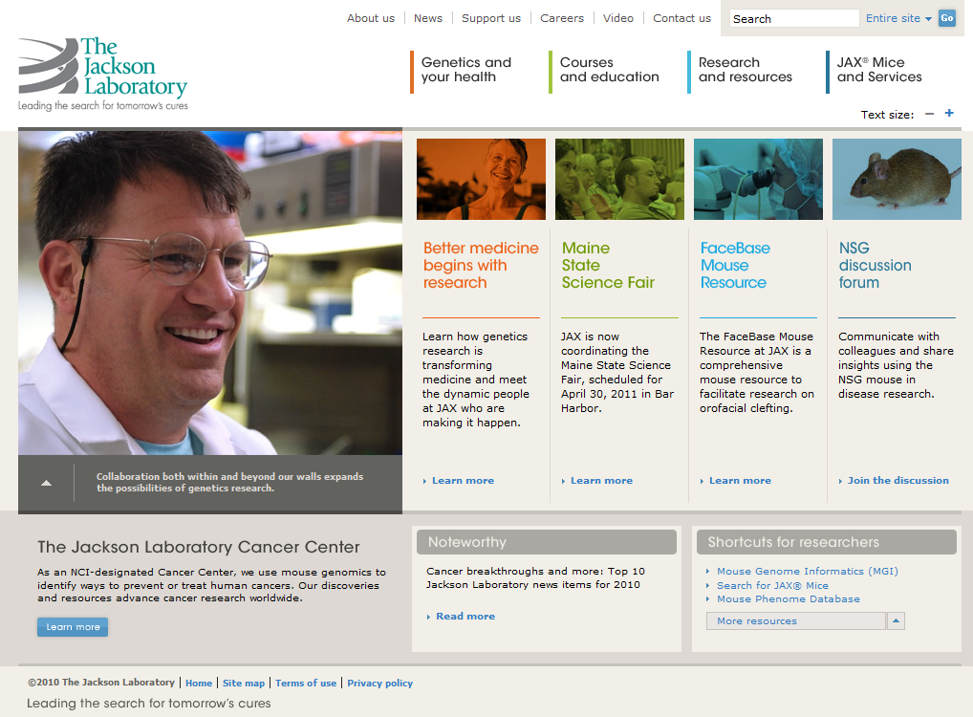
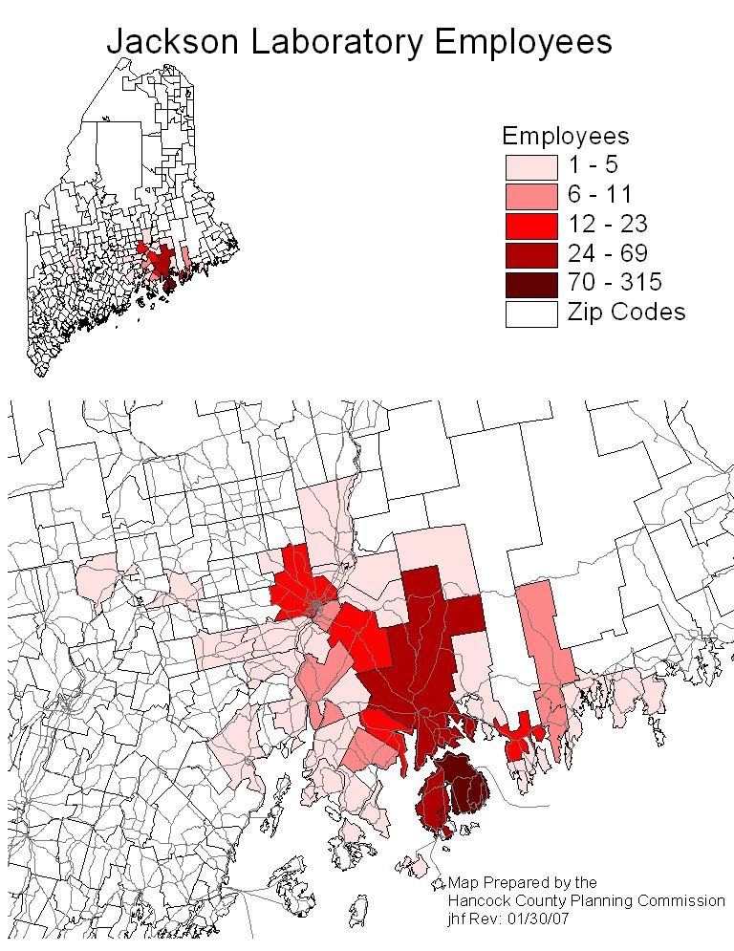
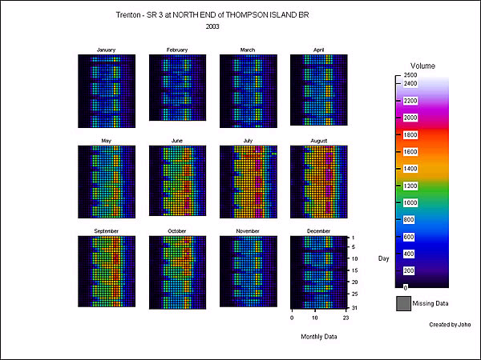
Customers: Commuters

Slide 8
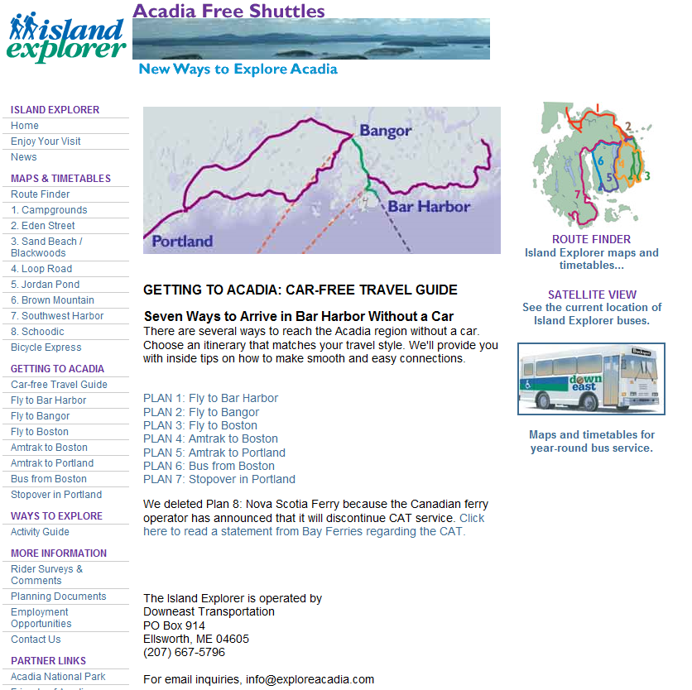
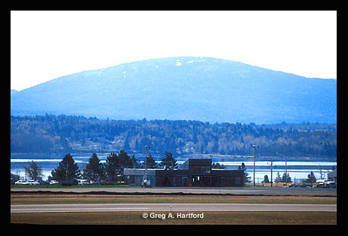
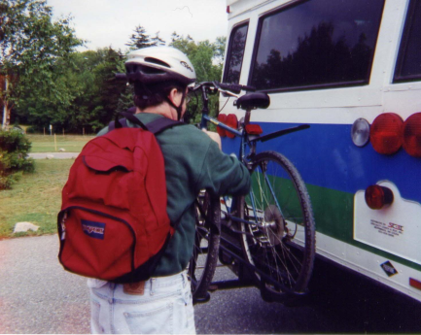
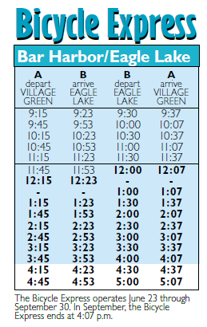
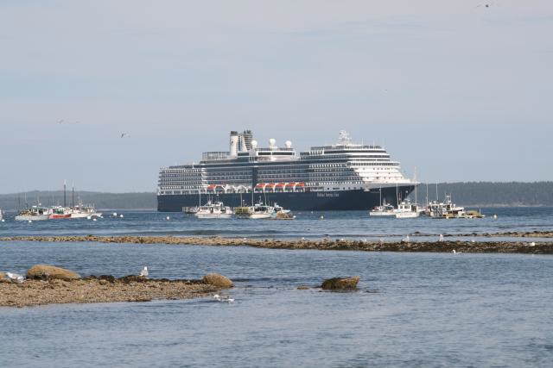
Customers: Car Free Visitors

Slide 9
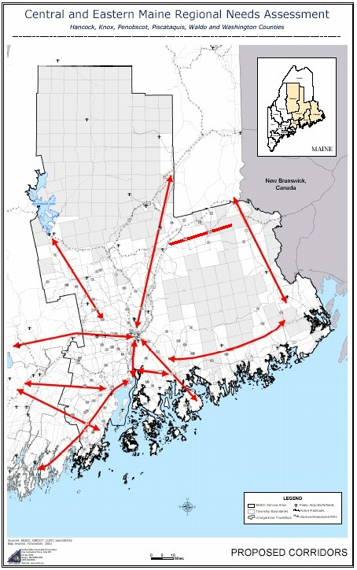
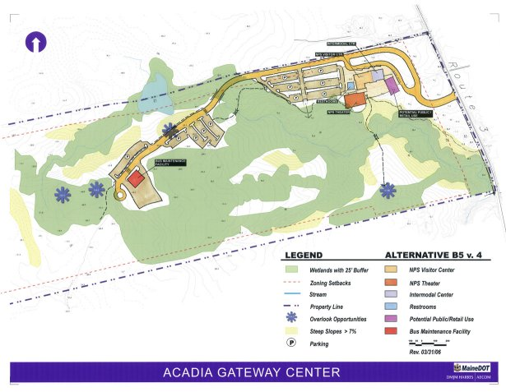
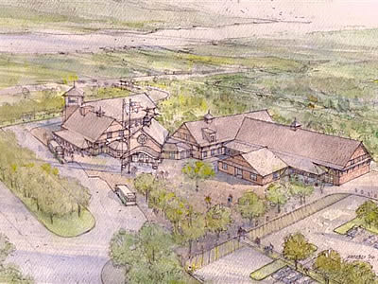
Customers: Day Users

Slide 10
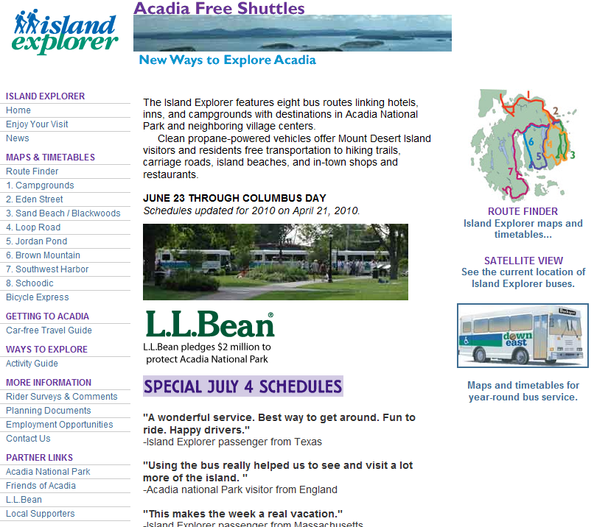
Promotion – on the Web

Slide 11
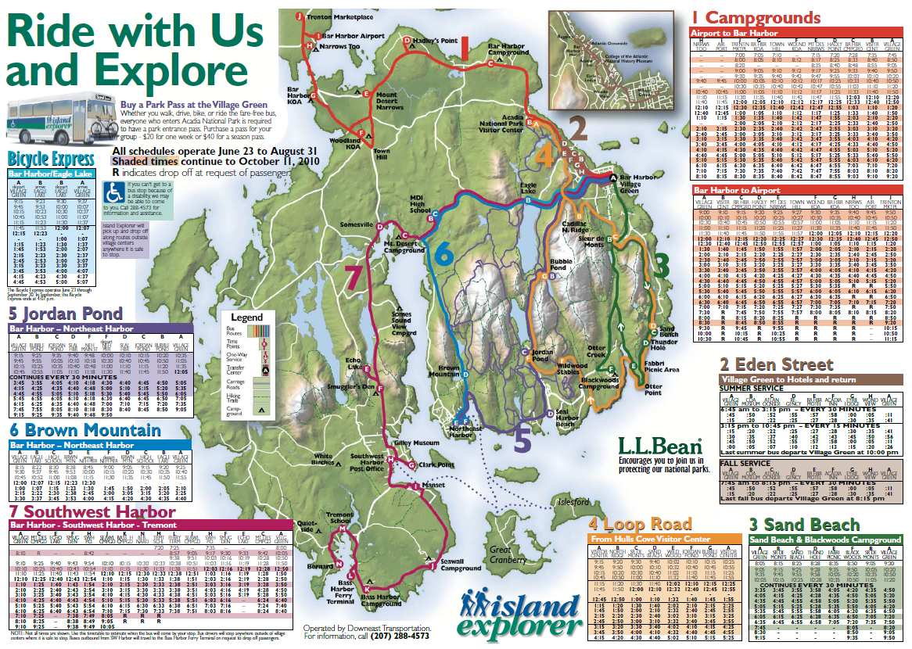
Promotion: Island Explorer
Takes Partners

Slide 12
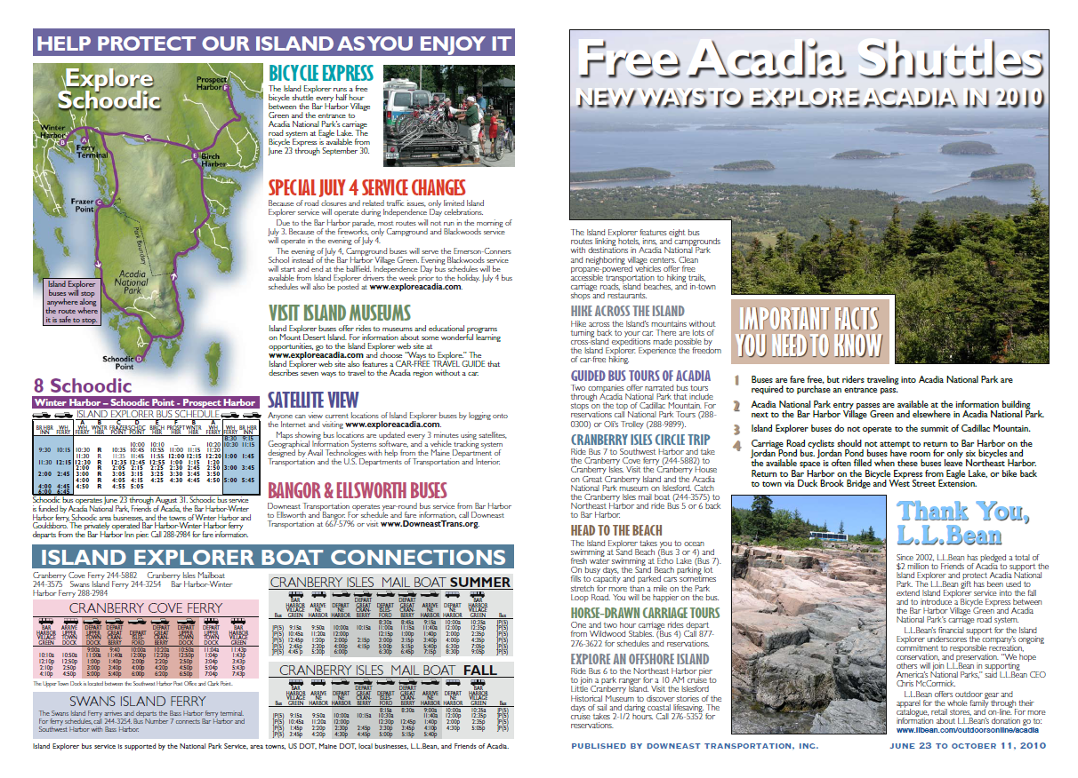
Price: Island Explorer

Slide 13
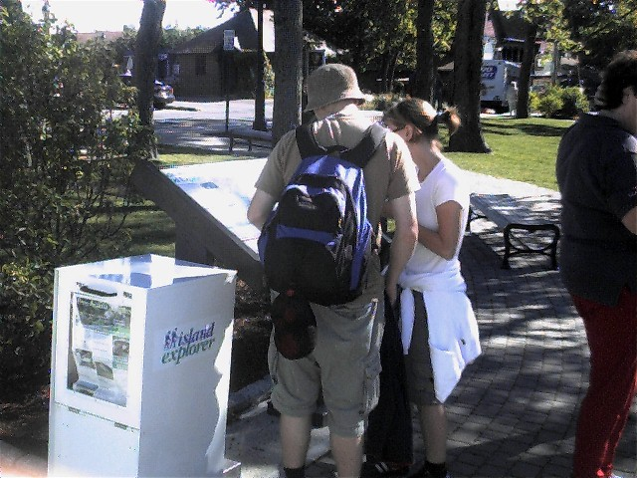

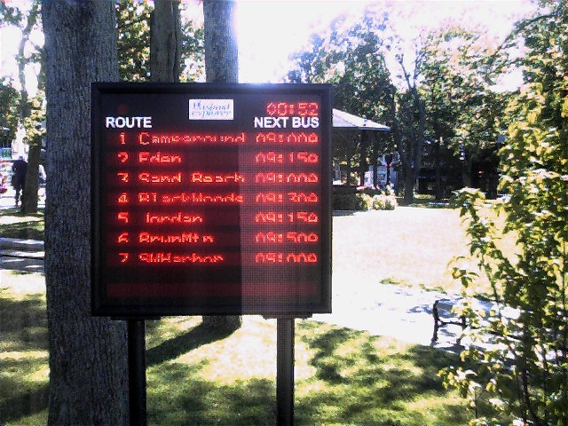
Placement – Intelligent Transportation Systems

Slide 14
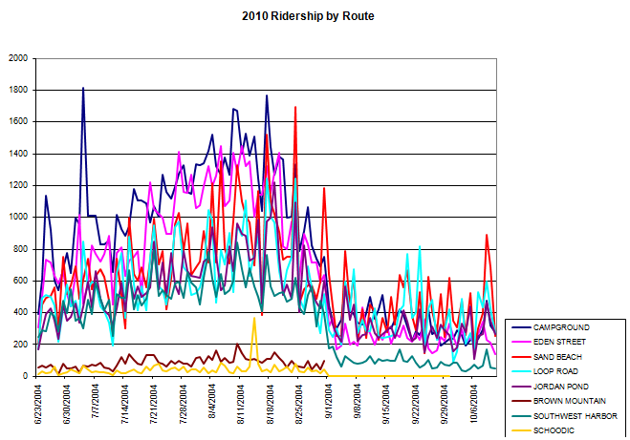
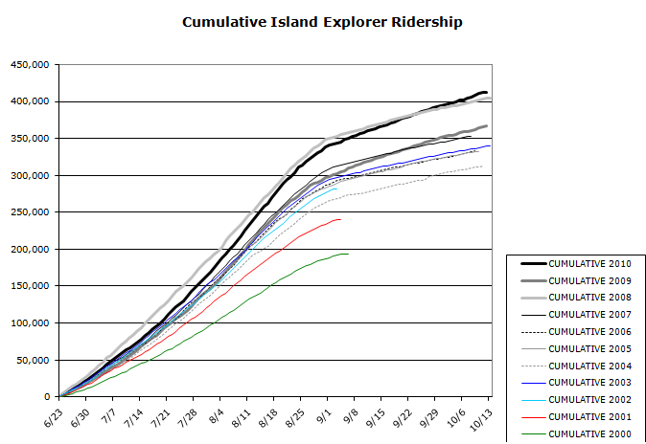
Ridership: 2010
This 12th season was a record setting year for the Island Explorer project.
Island Explorer buses carried 412,132 riders in 2010. This is 13% higher than 2009, and 2% higher than 2008.
An increase in fall cruise ship riders during the past two seasons is what pushed 2010 higher than 2008.
Fall ridership in 2010 was 4% higher than fall ridership in 2009, and 31% higher than fall ridership in 2008.
For the summer of 2010, the Island Explorer total was 338,223, the daily average was 4,832, and the one-day peak was 8,010.
For the fall of 2010, the total was 73,909, the daily average was 1,895, and the one-day peak was 3,139.
Use of the Bicycle Express in 2010 increased 9% over 2009. Use of the summer-only Schoodic bus increased 65%.

Slide 15
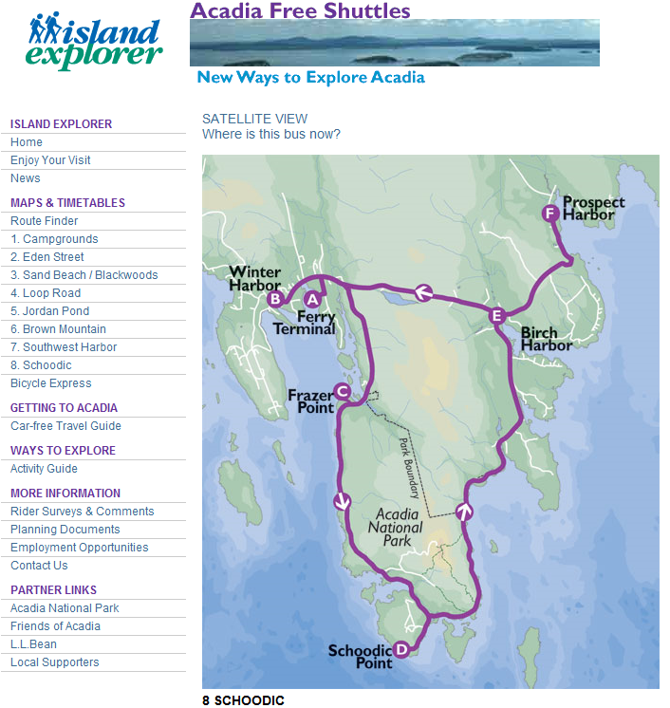

Placement: Schoodic Shuttle

Slide 16
Promotion: Regional Transit System
Broad but Shallow

Slide 17
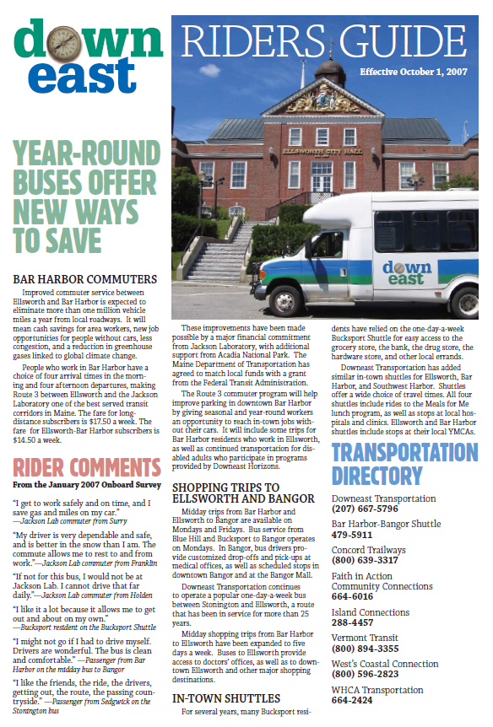
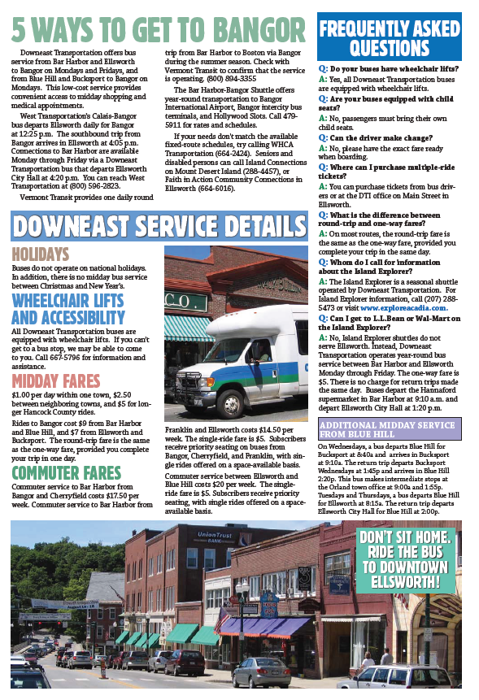
Promotion: Regional Bus Service

Slide 18
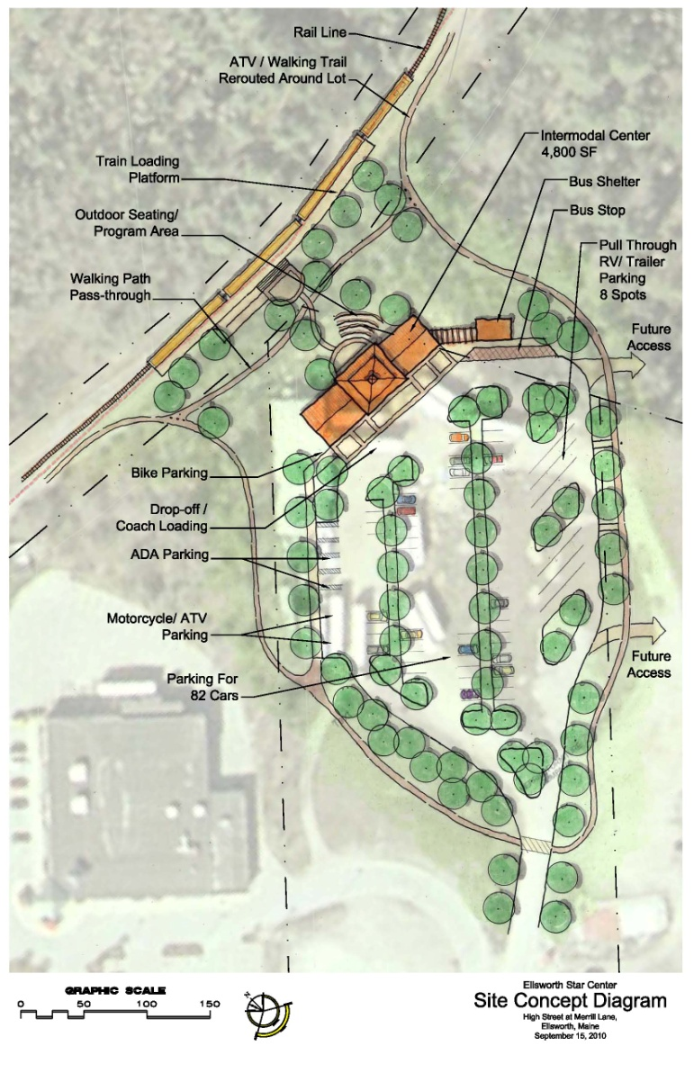
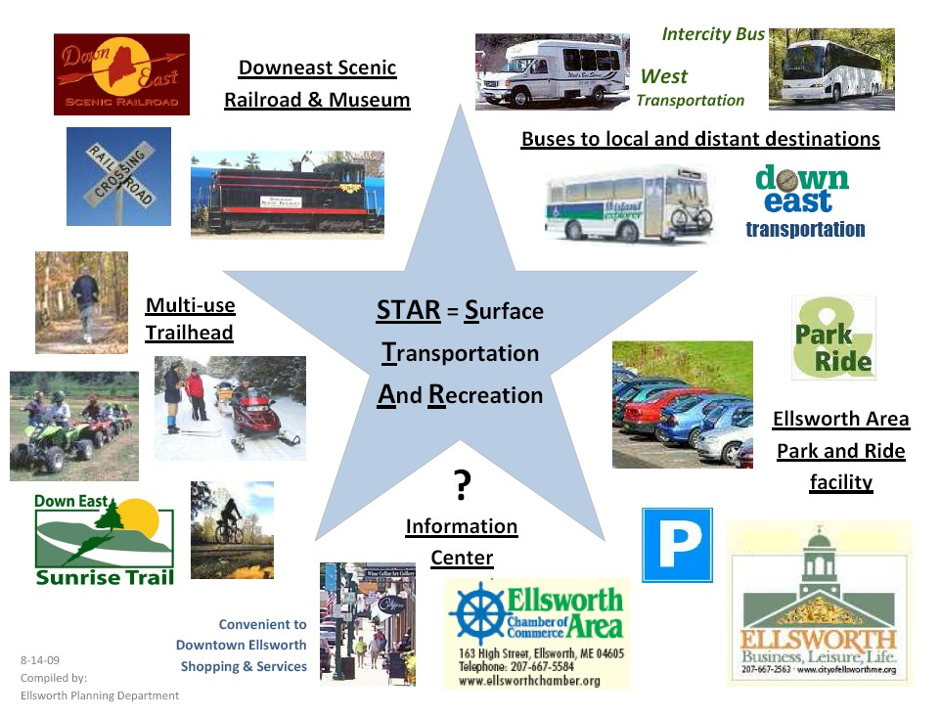
Placement: Ellsworth STAR Center

Slide 19
Contact Information
James Fisher, PhD, AICP
Hancock County Planning Commission
395 State Street
Ellsworth, ME 04605
(207 667-7131 / (207) 667-2099 (fax)
jfisher@hcpcme.org
Transportation Services www.exploreacadia.com www.downeasttrans.org | Byways www.acadiabyway.org www.schoodicbyway.org www.blackwoodsbyway.org
Tourism www.downeastacadia.com www.downeastexplorer.org | Planning www.hcpcme.org www.wccog.net www.maine.gov/mdot

